Slide 1
To Kill A Mocking Bird
By Harper Lee

Slide 2
Nelle Harper Lee
Born April 28, 1926 in Monroeville, Alabama
Daughter of Frances Fincher Lee, who was a lawyer in Monroeville
Published To Kill a Mockingbird in 1960
1961 – Novel won the Pulitzer Prize
First and last novel she completed

Slide 3
Edgar H. Schuster:
“The achievement of Harper Lee is not that she has written another novel about racial prejudice, but rather that she has placed racial prejudice in a perspective which allows us to see it as an aspect of a larger thing; as something that arises from phantom contacts, from fear and lack of knowledge or education that one gains through learning what people are really like when you finally see them.”

Slide 4
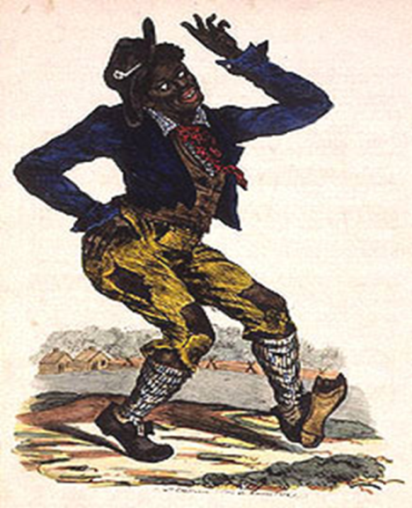
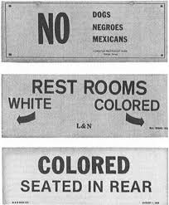
Jim Crow Laws – Historical Context
1863: Emancipation Proclamation is passed by Abraham Lincoln declaring freedom for all slaves with the intentions of preventing slavery from expanding.
Well into the 1960s, African Americans were still denied many basic rights.
Civil Rights Movement began to take off in the 1950s

Slide 5
Jim Crow Guide
A Black man could not offer his hand to shake hands with a White man because it implied being socially equal. Obviously, a Black man could not offer his hand to a White woman, because he risked being accused of rape.
Blacks and Whites were not supposed to eat together. If they did eat together, Whites were to be served first.
Under no circumstances was a Black man to offer to light the cigarette of a White female – the gesture implied intimacy.
Blacks were not allowed to show PDA in public.
Whites did not use courtesy titles such as Sir or Miss when referring to Blacks. Instead, they were called by their first names or “boy” or “girl” regardless of age.
White motorists had the right-of-way at all intersections.

Slide 6
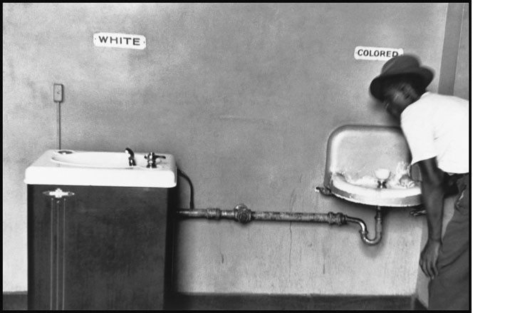
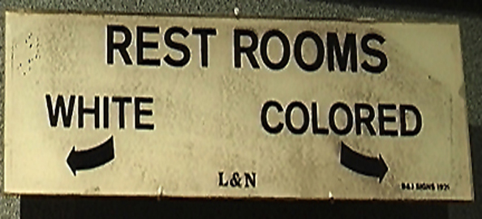
The Movement fought against :
Segregation of schools, drinking fountains and bathrooms

Slide 7
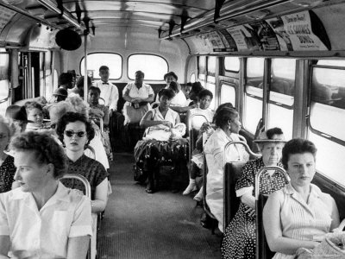
The Movement fought against :
Being forced to ride in the back of public buses

Slide 8
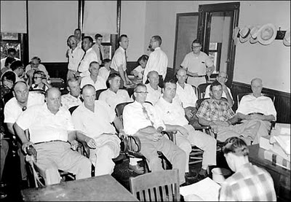
The Movement fought against :
Only white, male property owners could serve on juries

Slide 9
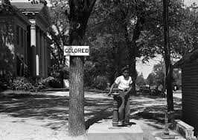
The Movement fought against :
The segregation of courthouses

Slide 10
Changes:
1957: Congress passes Civil Rights Act but this didn’t give African Americans full protection.
1964: Civil Rights Act is passed enforcing protection and enforcement of rights.
1965: Voting Rights Act is passed.
1968: Civil Rights Bill is passed. Laws banned racial discrimination from public places, workplaces, polling stations and housing.

Slide 11
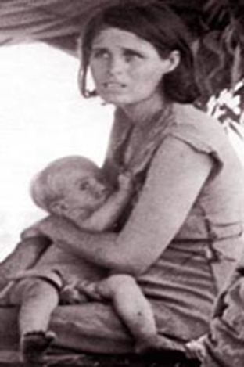
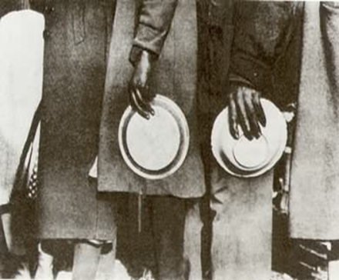
The Great Depression
1929-early 1940s: Stock Market crash displaced many workers.
Unemployment Rate: over 25%
Hit everyone hard, especially the South
The Great depression made race relations worse

Slide 12
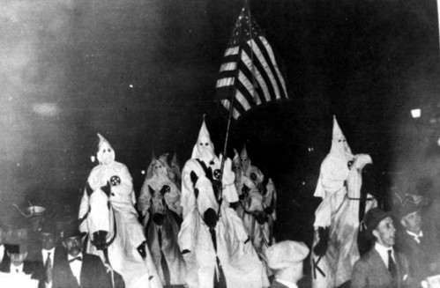
Relations between Blacks and Whites
Tensions escalated as racist groups like the Ku Klux Klan terrorized Blacks out of their jobs
Nearly 5000 Blacks were lynched between 1860 – 1890s
Lynching: common in the South during 1930s, it was a form of punishment used by mob groups to maintain supremacy.

Slide 13
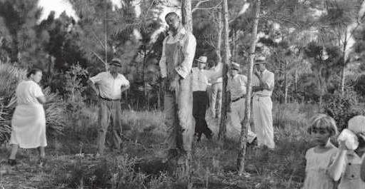

Slide 14
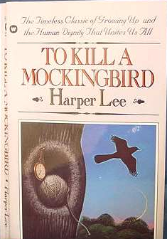
To Kill a Mockingbird Literary Context
It is in this setting that the novel takes place
In a small town, in the deep South, in the early 1930s

Slide 15
To Kill a Mockingbird Writing Context
Lee wrote the novel during a time of even greater social turbulence in the US – The Civil Rights Movement
In the 1950s, attitudes were beginning to change and Black Americans were no longer willing to be treated as lesser human beings.

Slide 16
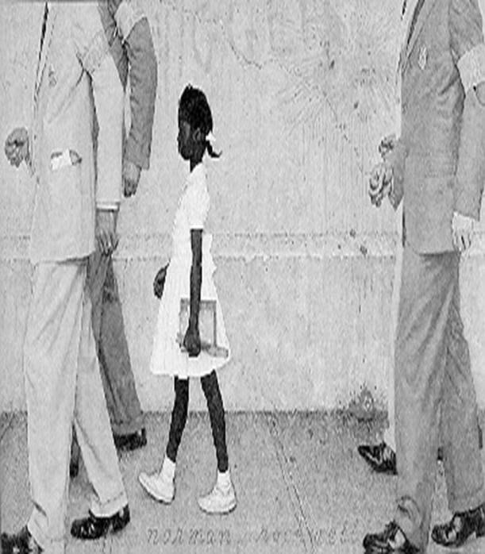
Brown vs. Board of Education
Passed in 1954 – landmark decision to grant Linda Brown, a Black fifth-grader, admission into a white elementary school in Topeka, Kansas

Slide 17
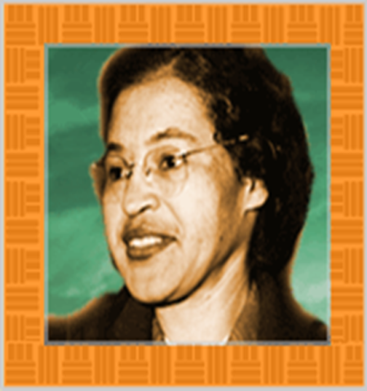
Rosa Parks and the Montgomery Bus Boycott
1955 – 42 year old Rosa Parks refused to give up her seat to a White man on a Montgomery County bus
Black residents stayed off buses for 13 months from 1955-1956
They started car pools to get around.
In 1956, the Supreme Court ruled that segregating public busses was illegal

Slide 18
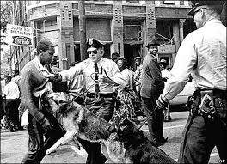
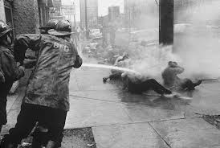
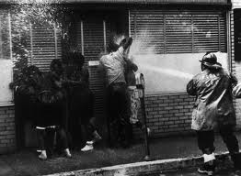
Television Changed Everything
Many families had televisions by this time and saw images of Southern race riots and violence. These events began to sink into the American consciousness.

Slide 19
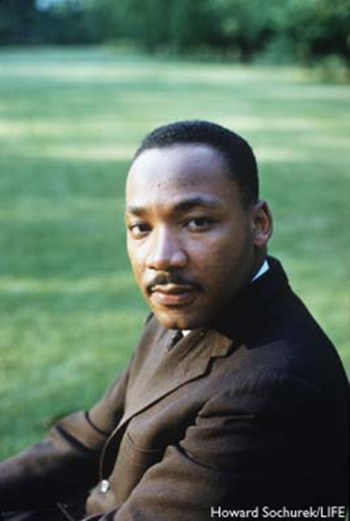
Dr. Martin Luther King (1929-1968)
Civil Rights Movement Hero – Began to organize Black Americans in order to fight oppression and for a country where all men were truly treated as equals.
Many freedom-fighters died for their efforts.

Slide 20
To Kill a Mockingbird
In the fall of 1960, in the middle of the Civil Rights Movement, To Kill a Mockingbird was published.
It shot to the top of the New York Times best seller list.
The country was finally ready to listen to the story of segregation and open their minds to the possibility of an America where Whites and Blacks could live together as equals.

